Slide 1
DENTAL MANAGEMENT SYSTEM
By
Dhaval Pandya
Yash Pandya
Prathamesh verlekar
Shivendra Shahi

Slide 2
DENTAL MANAGEMENT SYSTEM
Introduction
Tech Used
Application
Design
Database Design Model
Entity Clusters
Master Data Load
Report/Dashboards
Calendar report
Tableau Dashboards

Slide 3
Introduction
Dental Management System is a database management system for monitoring and handling the appointments and other related activities in a Dental Office.
Dental Management System is specially designed to let the staff have high efficiency management tools, computerized and systematic patient records, and detail of treatment records.
This system also provides an appointment feature, which allows staff to view the appointment that is already made by the dentist/patient.
The patient treatment module consists of the information about the tooth examination and record of treatment that has been done.

Slide 4
Tech Used
TOAD Data Modeler
Database model & Generated Script
SQL Server Management Studio
Database
SQL Server Integration Services
Loaded master data through Excel
SQL Server Reporting Services
Calendar report of Dentist’s upcoming appointment
.NET
Front End
Tableau
Appointment and Inventory dashboards Tableau

Slide 5
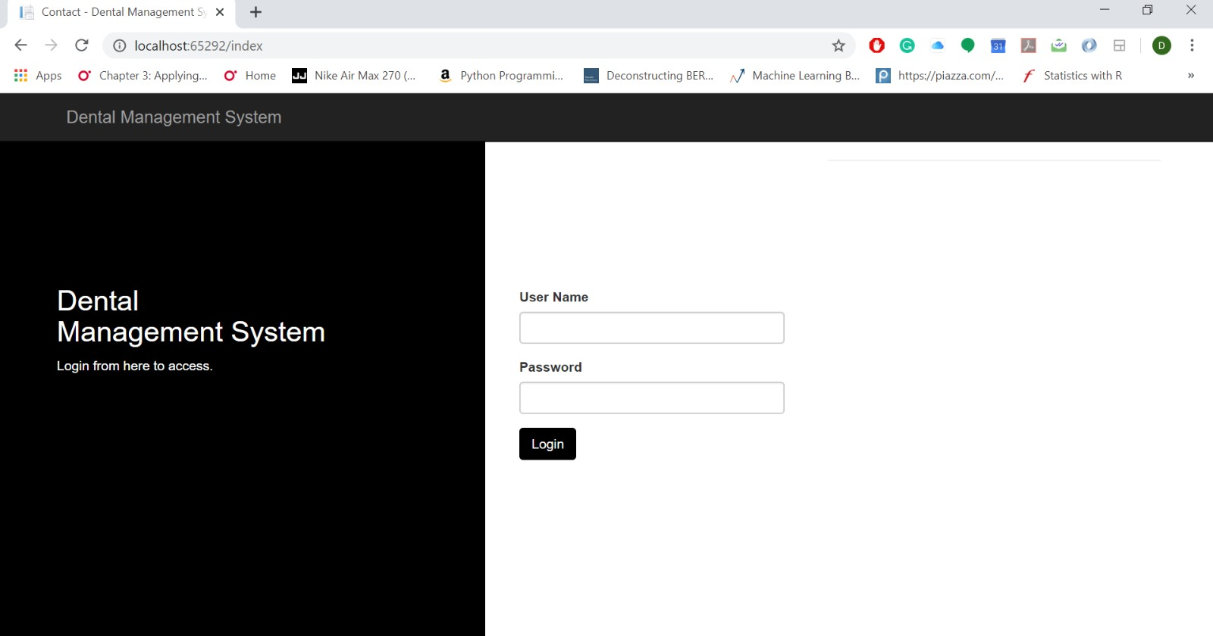
Application

Slide 6
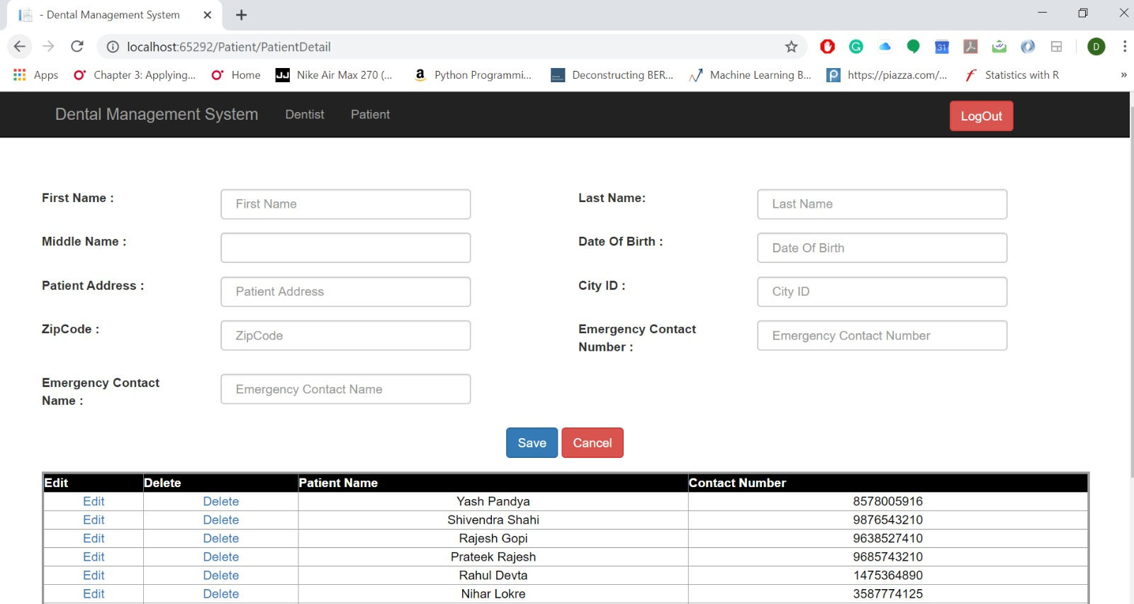
Application cont.

Slide 7
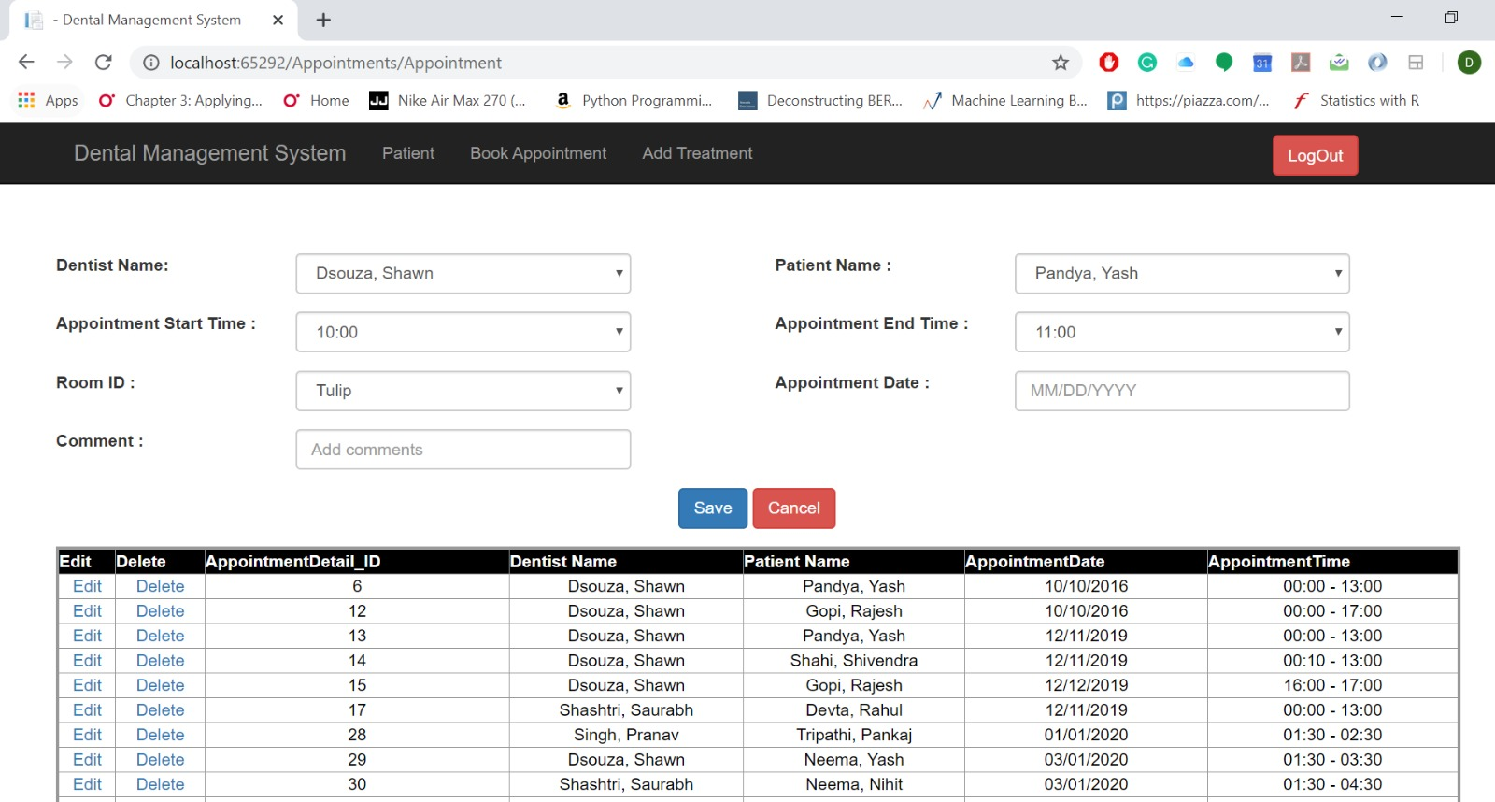
Application Cont.

Slide 8
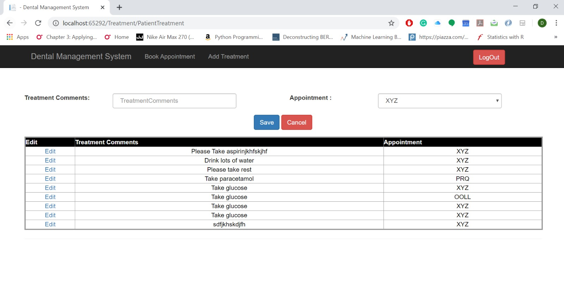
Application Cont.

Slide 9
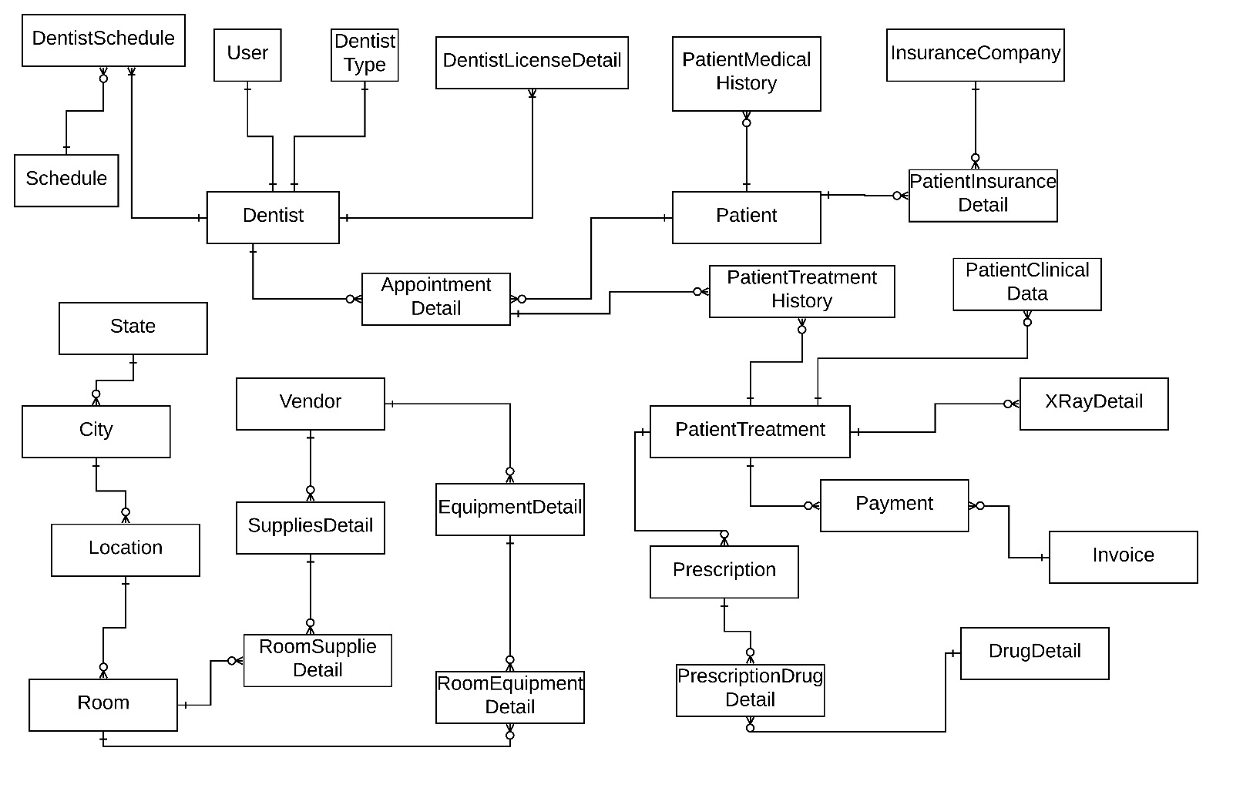
Database Design Model

Slide 10
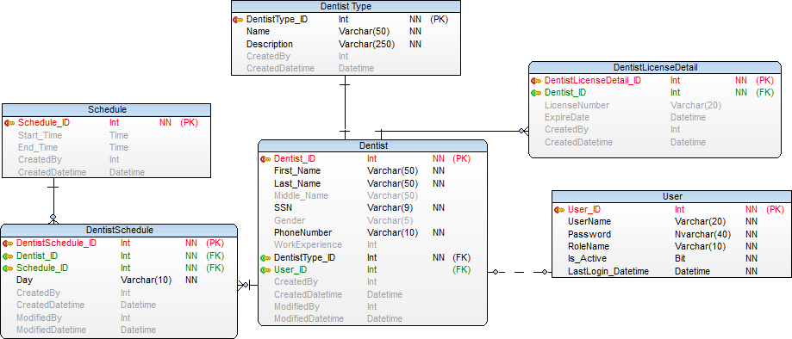
Entity Cluster Dentist

Slide 11
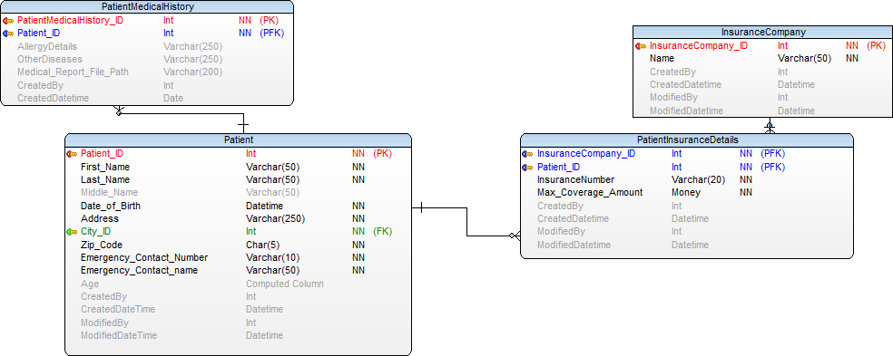
Entity Cluster Patient

Slide 12
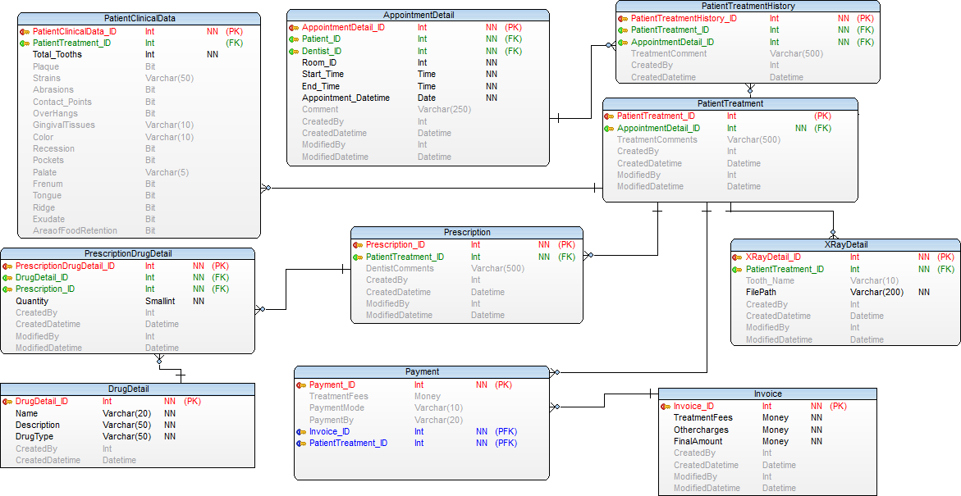
Entity Cluster Treatment

Slide 13
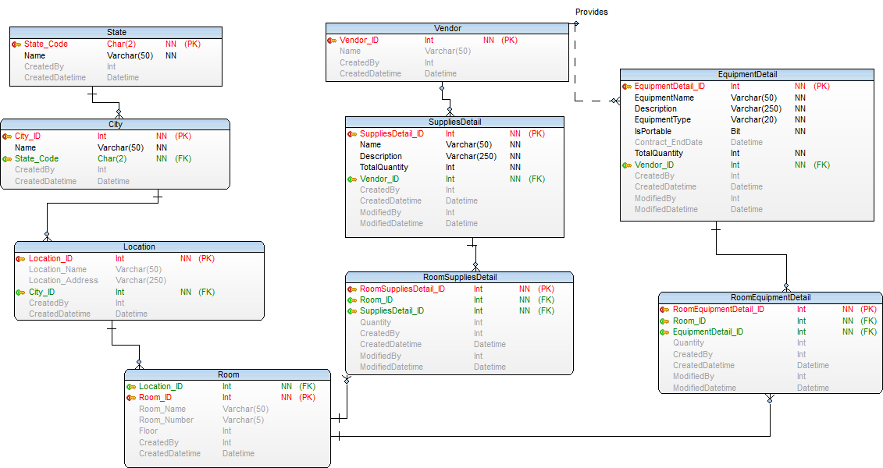
Entity Cluster Inventory

Slide 14
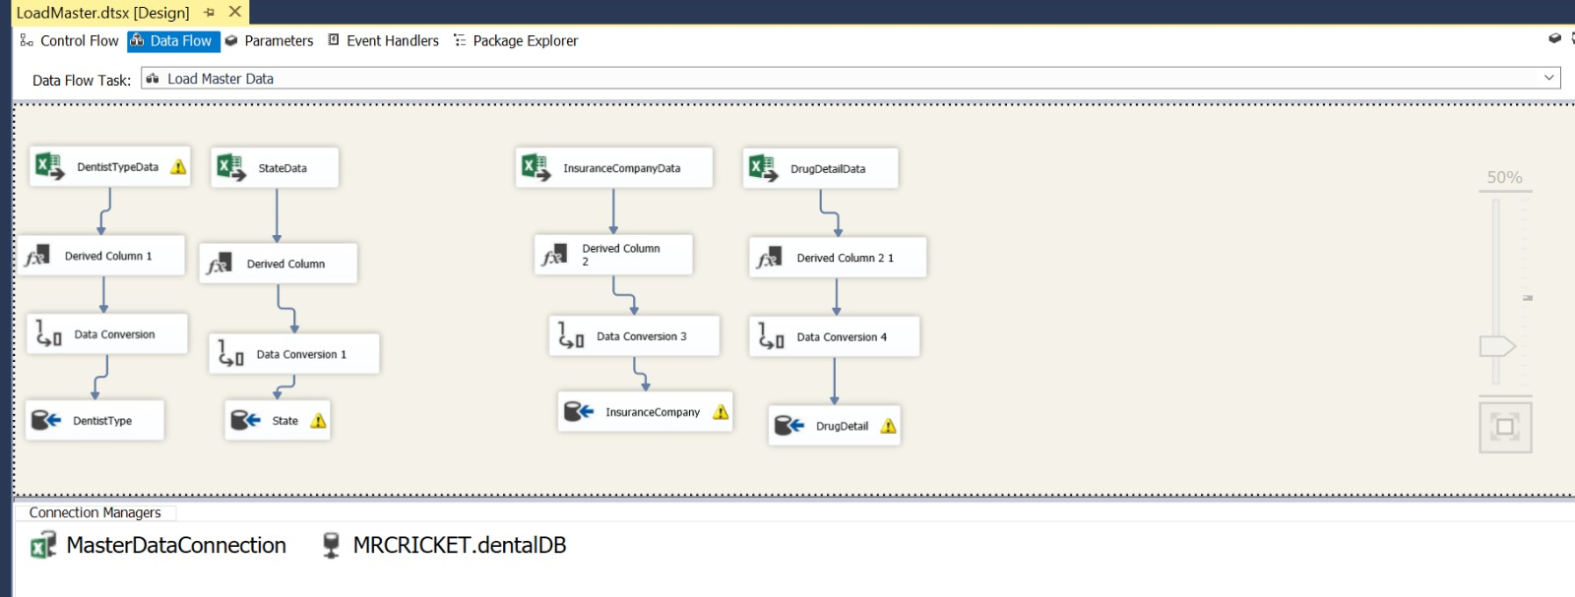
Master Data Load using SSIS

Slide 15
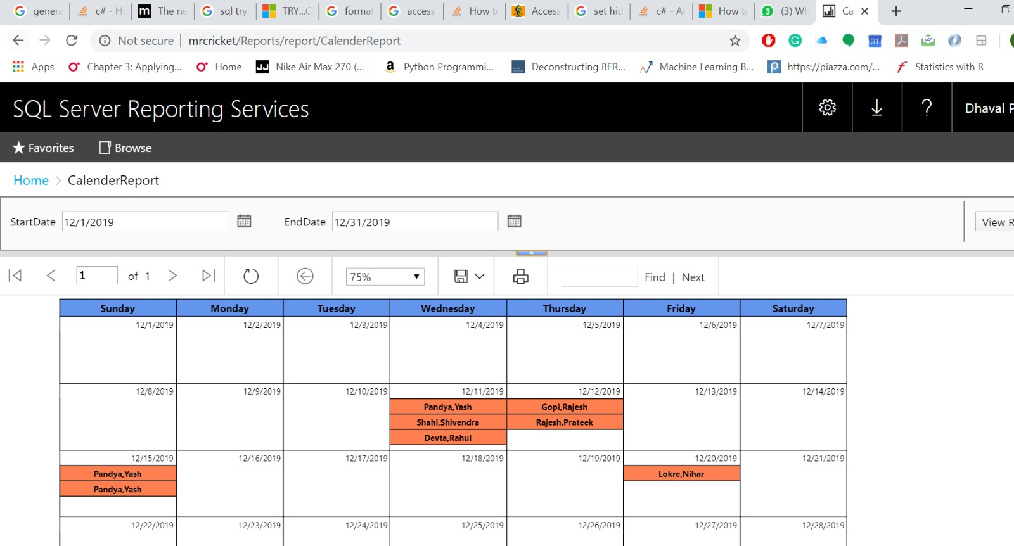
Calendar Report

Slide 16
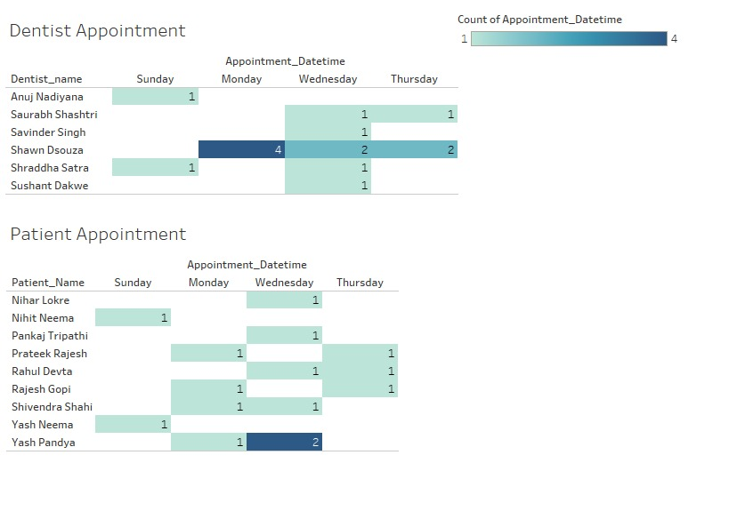
Tableau Screenshots
https://public.tableau.com/profile/yash.pandya#!/vizhome/Book1_15762113807330/Dashboard1?publish=yes

Slide 17
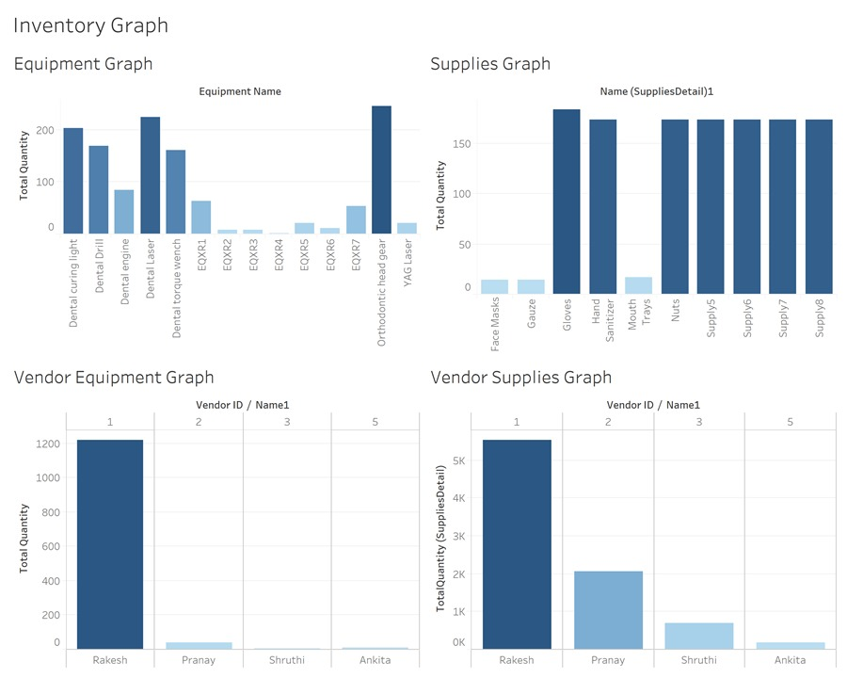
Tableau
https://public.tableau.com/profile/prathamesh.verlekar#!/vizhome/InventoryDashboard_15762115907250/Dashboard1?publish=yes

Slide 18
SQL Objects
SQL Object | Total Numbers
Tables | 29
Store Procedures | 20
Triggers | 1
Views | 1

Slide 19
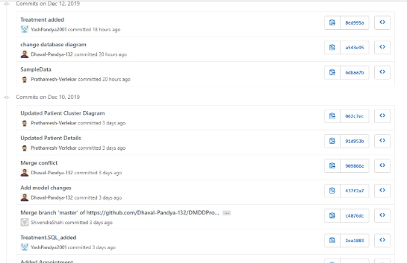
GIT Commits

Slide 20
References
A Dictionary of Dental Terms (tm)
https://www.bracesinfo.com/glossary.html
Dental Instrument
https://en.wikipedia.org/wiki/Dental_instrument

Slide 21
THANK YOU !!

